Slide 1


Leading a Virtual Team
Notes:
Hello and welcome to Leading a Virtual Team! My name is Maritza Torres, and I will be your facilitator. In this course you will be able to access tools and use best practices to support your leadership effectiveness as you guide your virtual team members!
Image from https://www.gettyimages.com/ through license at work

Slide 2

Learning Objectives
Discuss the importance of developing trustworthy relationships
Recognize priorities of leading a virtual team
Identify the benefits and challenges of virtual teams
Access tools and use best practices to support your virtual team
Notes:
By the end of this course, you’ll be able to
Image from https://www.gettyimages.com/ through license at work

Slide 3

Working on a Virtual Team
Notes:
Alright so let’s get our day started with talking about “working from home.” According to census.gov “More than a third of U.S. households reported working from home more frequently than before the pandemic, but the percentage who made the switch varied widely across sociodemographic groups.” Although there were remote jobs pre-pandemic, the ability to work remotely has tremendously increased since the pandemic started. In this section of the presentation, we are going to go over and discuss the benefits and challenges of working virtually.
Image from https://www.gettyimages.com/

Slide 4
Working Virtually Is:
  Fully remote
  Hybrid remote
Notes:
I want to start this section off with some definitions of what we mean when we say, “working virtually”. In this presentation we will be talking about virtual teams that are fully remote and/or hybrid remote. We recognize each department have different virtual work environments and wanted to ensure all we were all on the same page as we discuss working on virtual/remote teams.
Fully remote: working all shifts at a remote location
Hybrid remote: working a weekly schedule partially from a remote location and partially from a shared space
Image from https://www.gettyimages.com/ through license at work

Slide 5

What are the benefits of working on a virtual team?
Notes:
Let’s start our discussion by talking about the benefits of working on a virtual team.
Image from https://www.gettyimages.com/ through license at work.
Lowered tone and color of image

Slide 6
Benefits of Working Virtually
Variety of communication platforms
Higher productivity
Improved work-life balance
Larger talent pool
Lower turnover rates
Increased job satisfaction
Notes:
According to LinkedIn Learning and other publications, there are a variety of benefits of working virtually. We have a variety of platforms we can use to communicate with our teams. For example, Microsoft Teams, Zoom, and One Drive are applications in which people can work on projects simultaneously in a remote work environment.
According to recent business research published in 2021, “The work-from-home boom will lift productivity in the U.S. economy by 5%, mostly because of savings in commuting time, the study says. The findings suggest the rapid adoption of new technology amid the pandemic will offer lasting economic gains, helping to boost sluggish productivity that has long weighed on global growth.” Just to clarify these are a list of benefits based on national studies and surveys.
There is improved work-life balance. People can create their own working environments in which they are comfortable and productive. They are also able to spend time with their pets or loved ones during breaks and/or establish their own wellness routines.
There is a larger talent pool because of accessibility and the lower turnover rates in companies that have a virtual working environment/option.
With increased job satisfaction, employees are feeling more “freedom” in their work and feel like they are saving time because they no longer have a commute and if the job allows, they can work at their own pace.
Image from https://www.gettyimages.com/ through license at work

Slide 7
What are the challenges working on a virtual team?
Notes:
Now, let’s focus on the challenges of working on a virtual team.
Image from https://www.gettyimages.com/ through license at work

Slide 8
Challenges of Working Virtually
Collaboration and communication
Lack of boundaries
Distractions at home
Technology issues
Time management
Loneliness and social isolation
Notes:
Collaboration and communication is a challenge because there are no longer face to face interactions or what I call “hallway meetings” to debrief projects or ideas. People have been relying on people’s nonverbals to figure out how they are feeling, however, some of that is lost in a virtual environment since we see (or don’t see) people in small boxes on our screen. Also, remote leaders have to readjust ways in making sure their team is staying on task since they are not able to pop into someone’s office for a quick check-in or visibly see their team working.
Some people may have a hard time separating their work and home environments. Some may have their office in the same room as their bedroom or living room. Due to this, there may be some blurred lines between work and home life.
Distractions can also be a challenge. Working virtually sometimes means working “with” other family members, kids, pets, other people at our local coffee shop, or repair people too! Also, being so close to your TV (Netflix anyone?) or house chores may distract you from doing a task at work.
Alongside distractions people can lose motivation to complete tasks when working virtually. While this is still possible in an office or at home, the lack of external stimuli and face to face interactions can have someone lose track of their long-term career goals.
Ok so wifi/and technology issues and availability! Has anyone here had issues with their wifi going out? Or online applications such as VPN not working?! I know I have had this happen to me a ton of times! It’s frustrating right?! We also need to keep in mind that not everyone is saavy with technology. To one person setting up their workspace and laptops might be exciting, while others are anxious and nervous about completing this tasks because they aren’t as knowledgeable with software and computer hardware.
Time management can become difficult, because for some of us we must make our own schedules and stick to them. Maintaining a routine from can be difficult especially during times of the day where you would rather take a nap than complete that report for your manager.
Lastly, loneliness and isolation. The lack of physical face to face interactions can effect’s one’s physical and mental health.
Image from https://www.gettyimages.com/ through license at work

Slide 9
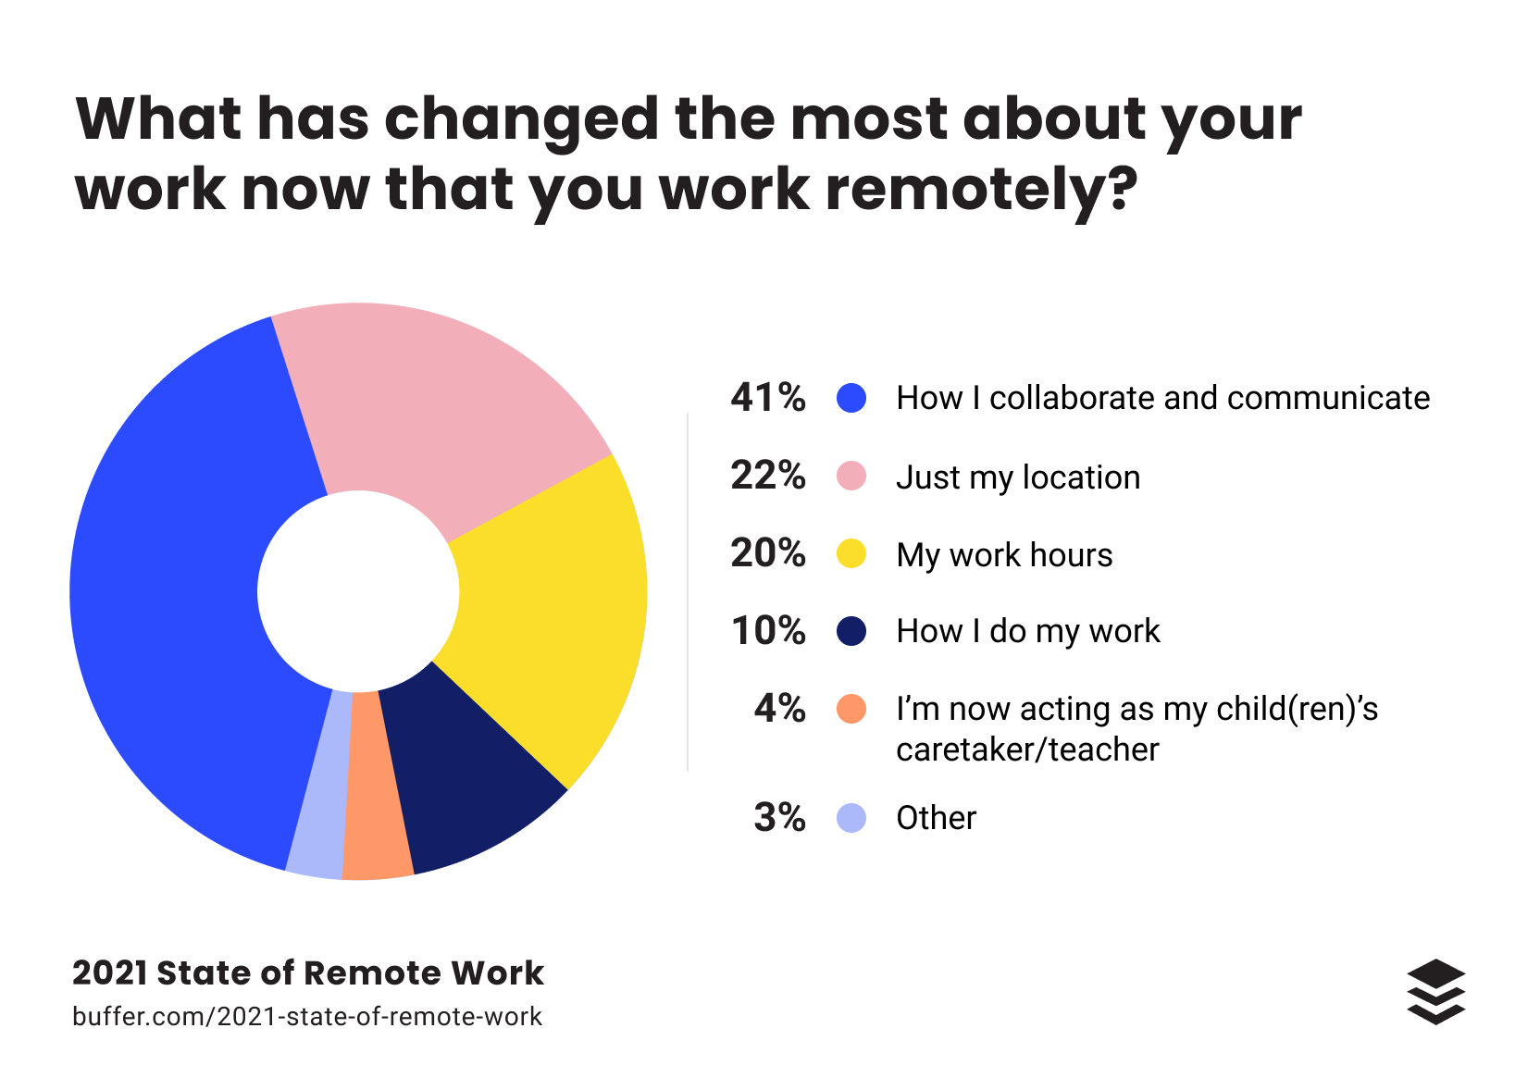
2021 State of Remote Work Report by Buffer
Notes:
Working from home also has its challenges. Many of us had to adapt to entirely new ways of working, new technology, and new routines. To sum it up in one word: CHANGE! There has been a lot of change when offices went remote, and people have been affected by it differently
Buffer, a remote based company who specializes in social media management software released a 2021 State of Remote Work report alongside other remote based companies and platforms. With over 2,300 responses they were able to determine that working remotely has changed how employees communicate and collaborate, where they work, work hours, how work is done, at home responsibilities, and of course other reasons that are not listed.
Image for buffer.com, I changed the color saturation and tone of the photo. When you click on the image it will take you to the website. I added a screentip when you hover over the image.

Slide 10

What is your role as a leader in helping reduce some of the challenges we discussed?
Notes:
As a leader of a remote team, its imperative to be aware of the challenges and benefits regarding working in a virtual environment. It is important emphasize that these benefits and challenges are not applicable to all people. Context matters and as a leader of a remote team we can learn about our team members challenges and benefits by cultivating relationships and building trust. Which leads us to the next section of our time together.
Image from https://www.gettyimages.com/ through license at work

Slide 11

Leading a Virtual Team
Notes:
Now it’s time to talk about leading a virtual team!
Image from https://www.gettyimages.com/ through license at work

Slide 12
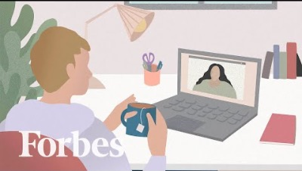
Notes:
Let’s watch a short clip from Forbes Magazine about Leading a Virtual Team!

Slide 13

Priorities as a Remote Team Manager
Building trust
Nurturing connections
Supporting team performance
Notes:
As a remote team manager, there are some priorities that you are responsible for. They are building trust, nurturing connections, and supporting your team’s performance. We are going to go over each of these in further detail.
Image from https://www.gettyimages.com/ through license at work

Slide 14

Building Trust
Notes:
When building trust, you must think about providing consistency and structure in a virtual team. It’s important to make sure everyone on the team understands their role and it’s consistent and fair. This can be done by developing working agreements and defining the norms in a virtual team.
Also, in distributing authority in a remote team, allow team members who are experts to take the lead on a project, and eventually give them the opportunity to coach a fellow team member in the process.
Another component to consider is fostering equality and transparency in a remote team. Be mindful when sharing information, and whether that information should be shared. Also, everyone on your team should be given equal times, opportunities, and mind space. Be sure to reward and recognize individuals Rewards need to be equal and constructive feedback should be given to team members.
Icons from Microsoft PP.

Slide 15

Nurturing Connections
Notes:
In nurturing connections, be sure to maintain regular contact with team members. A quick check in via chat on Teams is a great way to do this! Be mindful of keeping consistent schedules for team or individual meetings. The first few minutes of each meeting should have a chance to share personal topics or updates. If you have new team members, they should be given time to introduce themselves to the team. Lastly, encourage team members to work on multiple projects and ask for help during team meetings. If possible, create time virtually or in-person for the team to interact with each other. Zoom socials or a luncheon are great ideas!
Icons from Microsoft PP.

Slide 16

Supporting Team Performance
Notes:
According to Keith Ferrazzi, best-selling author who spent 20 years coaching high performance teams, along with building trust and nurturing connections, these are some of the top the attributes of a high-performing team.
There is candor. How open and sincere is your team with one another? Are they able to communicate with one another courageously and boldly?
Collaboration. Is your team looking for ways to work with others to brainstorm issues or for collaboration opportunities?
Development. Are you team members looking for challenge and support in their professional development? Are they coaching or mentoring their fellow team members and helping them address their strengths and areas of improvement?
Outcomes: Is your team committed to high-performing outcomes and transformational outcomes?
Icons from Microsoft PP.

Slide 17

Best Practices in Leading a Remote Team
Establishing team expectations
Meeting best practices
Sustain team energy
Notes:
Now let’s explore some (additional) leadership techniques to support success in a virtual environment; they include:
Image from https://www.gettyimages.com/ through license at work

Slide 18
Establishing Remote Team Expectations
Project deadlines
Meeting behavior
Set working hours
Use of software to track work and communication
Scheduling meetings and one- to-one connections
Notes:
To continue building trust on your team, be sure to establish clear expectations around working hours, project deadlines, and meetings. For example, scheduling regular one-to-one connections with your team members to check in and to discuss progress on assigned tasks. Working with your team to establish what working hours they should be “online” can add structure to your team’s workday and will ensure everyone is on the same page. Also, using Microsoft Teams statuses to share with people whether your busy working on a project, on a call, or away from your computer.
Image from https://www.gettyimages.com/ through license at work

Slide 19
Best Practices in Virtual Meetings
Tone
Body language
Eye contact
Turn off self-view
Maintain a professional appearance
Rules of Engagement
Notes:
I think it’s fair to say we have sat through a fair share of good and bad meetings. As a leader, one of your main roles is to lead meetings; and there are many components that can make a meeting go well or not. In a virtual world, it’s especially imperative to be mindful of how you lead virtual meetings. Here are just a few best practices on conducting virtual meetings.
First, be aware of your vocal tone and body language.
Communication can be broken down into 3 components: tone, words and body language. Which of these components do you think is the most important as we relay our message? Type your answer in the chat – tone, the words we use or body language.
One of the most popular communication research states, "words are only 7% of how we receive communication, while 38% is your tone of voice and 55% is your body language." Does that surprise you?
Since body language can be hard to decipher in a virtual environment, tone becomes increasingly important. This is where emotional intelligence plays a pivotal role. Your tone can set the tone of a meeting. Be sure to assess your mood before entering a meeting and adjust accordingly. Adjust your body language to show you actively listening to your team, sit up straight, make eye contact by looking at the camera or shifting your gaze to each person as they begin talking, but increase your eye contact to the camera.
Sometimes in virtual meetings our eyes tend to shift to ourselves. I know I’m guilty of doing this! Anyone else tend to look at their own video thumbnail during meetings and sometimes adjust their appearance? It’s suggested to turn off the self-view to help you focus on the meeting and your team members. Next, maintain a professional appearance (and this can be determined by the culture of your organization and department) when you are in meetings or having 1:1 meetings with your team. In some instances, you may not be as casual as you would like, or you will have to look professional if conducing a presentation. Dress accordingly.
Lastly, make sure everyone in the meeting is aware of the “rules of engagement.” Are your team members able to unmute themselves to answer questions? Can they use the chat feature to respond or ask questions? How about those reaction buttons? Are emoji’s or gifs allowed in the meeting? Setting the expectation of how to engage in virtual meetings from the beginning will help. Also, engage with your audience! Ask questions to encourage participation, give people time to pause and reflect and allow for responses, or have a meeting agenda ready so people are aware of the direction of meeting.
Image from https://www.gettyimages.com/ through license at work

Slide 20
Sustain Team Energy
Energy level check
Celebration and recognition
Gratitude
Encourage recovery breaks
Notes:
Often in a remote environment people can get fatigued and burned out. There are multiple ways in which you can keep your team motivated and energized to support one another and to cultivate creativity.
Here are a few recommendations to help sustain your remote team’s energy. At the beginning of each meeting do an energy level check with your team. Ask them to rate their energy levels from 1-10, 1 being the lowest and 10 being the highest. Or depending on the virtual platform use one of the interactive tools to have your team members tell you how they are feeling. In Zoom you can use the reactions button or in Microsoft Teams you can have them use gifs in the chat.
Make sure to celebrate and recognize any accomplishments your team has done for the week. Also, allot time during your meeting to give your team members the opportunity to recognize one another.
Celebration and recognition also align with the practice of gratitude. Use moments in the meeting to thank your team members or encourage others to express gratitude.
Image from https://www.gettyimages.com/ through license at work

Slide 21
Thank You!
Notes:
Changed background image transparency.
Image from https://www.gettyimages.com/ through license at work

Slide 22

Maritza Torres, Ph.D.
Maritza.Torres@knights.ucf.edu
Maritza Torres, Ph.D.
Maritza.Torres@knights.ucf.edu
Notes:
Changed the color of the image to gray. Image from stock photo on PowerPoint through Creative Commons.
Click on the laptop to go back to the beginning of the presentation. I also added a screentip when you have over the image.
Text overlay- name, email address, and computer icon are part of the image.

